Slide 1

Exploring Size-Speed Trade-Offs
in Static Index Pruning
Juan Rodriguez Torsten Suel
Tandon School of Engineering
New York University
Brooklyn, NY
Supported by NSF Grant IIS-1718680 and Amazon.
Juan Rodriguez
IEEE Big Data 2018 - Seattle, WA

Slide 2
https://github.com/JC-R/BD2018
IEEE Big Data 2018

Slide 3
Introduction
Inverted Index: structure used in search engines
For each word, we store where it is used
Inverted list for term t contains index entries (postings)
Postings have form (did, f) where did is the ID of a
document containing t and f is the number of occ.
IEEE Big Data 2018 - Seattle, WA

Slide 4
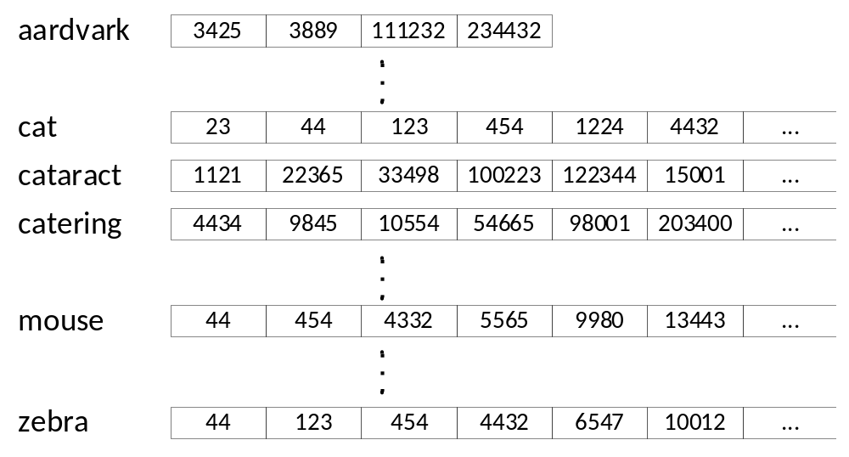
Introduction
Inverted Index
term
posting (inverted) list
posting
IEEE Big Data 2018

Slide 5
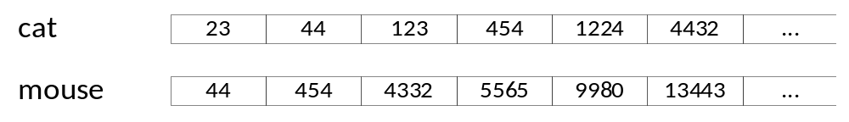
Problem Definition
+
Query processing in a nutshell:
Traverse inverted lists for query terms
Apply a ranking function to docs in union or intersect
E.g., cosine, BM25, or more complex ranker
Then return the top-k results to the user
IEEE Big Data 2018

Slide 6
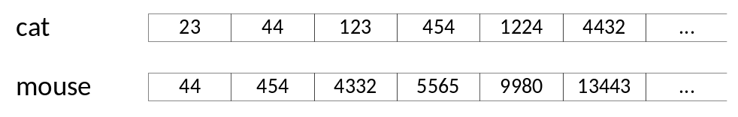
Problem Definition
Many inverted lists are very long
We cannot afford to traverse and rank complete lists
search engines use shortcuts: “early termination techniques”:
- Index tiering, impact ordering, maxscore/wand etc.
- Index pruning is one early termination (ET) techn.
IEEE Big Data 2018
Notes:
Query processing performance challenge:

Slide 7
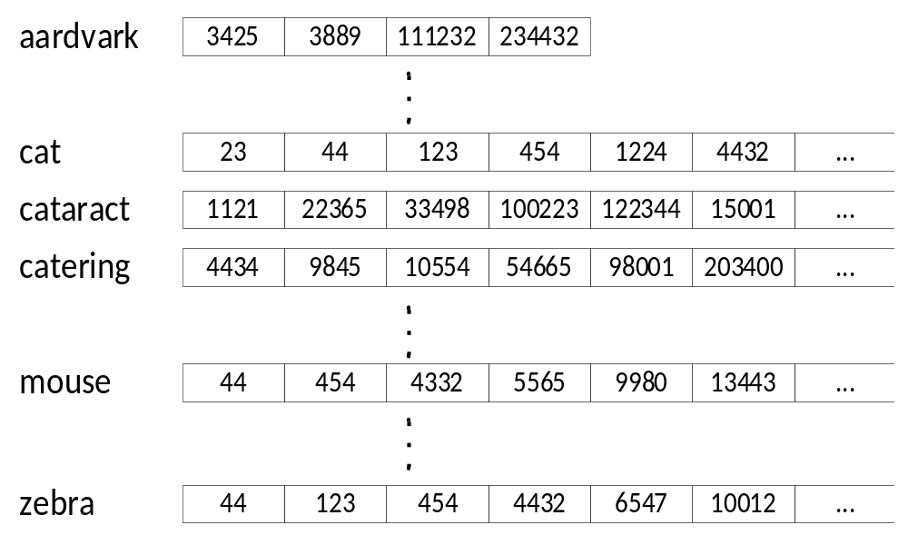
Index Pruning
“would anybody search for doc 454 using this term?”
“will this posting ever lead to a top-k result for a likely query?”
If “no”, remove this posting from the index
IEEE Big Data 2018

Slide 8
Motivation – Index Pruning
Goal: Remove postings that are (fairly) useless, while keeping quality “almost” the same
Why? Shorter lists lead to faster query processing
Smaller indexes: need less RAM or disk accesses
Smaller indexes: bring search to devices at the edge
Index pruning is a non-safe ET technique (lossy)
IEEE Big Data 2018
Notes:
Performance: shorter lists: less traversal
→ results after pruning are not exactly the same

Slide 9
Index Pruning
Motivation
Suppose a search engine indexes 4 trillion documents
250 index entries per document → 10^15 entries
5B queries per day, with 3.4 terms on average
< 170 billion index entries lead to top-10 in a month
Actually, far less ...
Can we find and remove them from the index?
IEEE Big Data 2018

Slide 10
Static Index Pruning
Related Work
Introduced by Carmel et al (SIGIR 2001)
A lot of subsequent work
Three main approaches:
  Algorithmic heuristics: based on impact, rank
  Hit-based methods: based on past top results
  Curation-based: build a high-quality subset
Not the same as spam detection/removal
IEEE Big Data 2018
Notes:
Algorithmic Heuristics:
Keep postings with impact score above threshold
In each list, keep the top x%, or the top x
Many combinations of these
Hit-based methods:
Use past query results to decide what to keep
Posting-based or document-based
Posting-based: we need a lot of queries
One solution: combine with heuristics (UP-QV, TCP-QV)

Slide 11
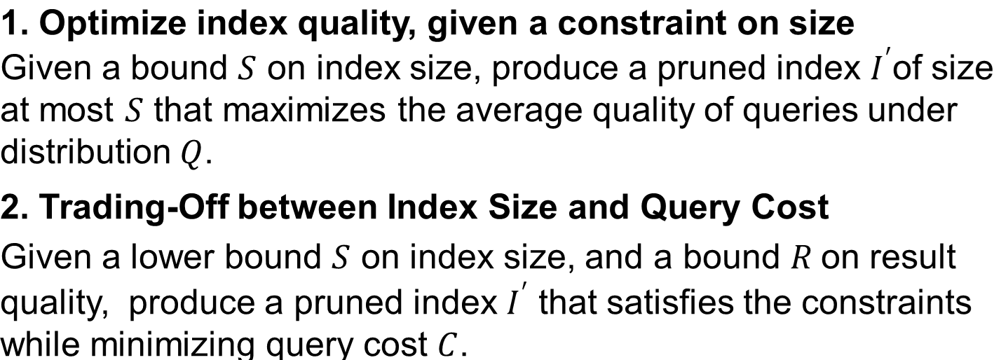
Static Index Pruning
Our Work
IEEE Big Data 2018

Slide 12
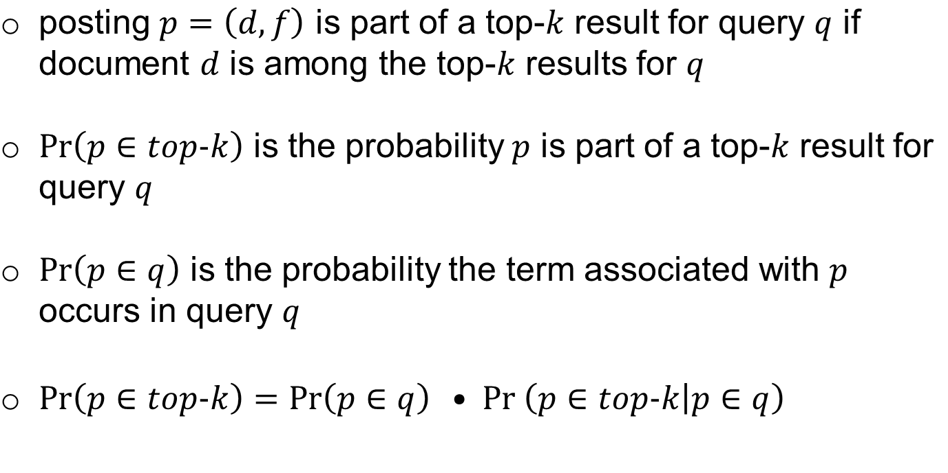
Static Index Pruning
IEEE Big Data 2018

Slide 13
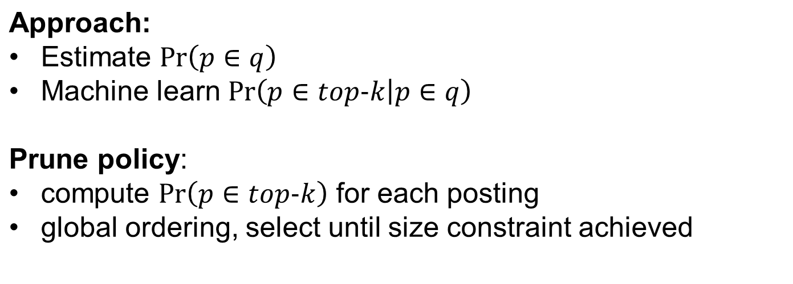
Static Index Pruning
1. Optimize index quality, given a constraint on size
IEEE Big Data 2018

Slide 14

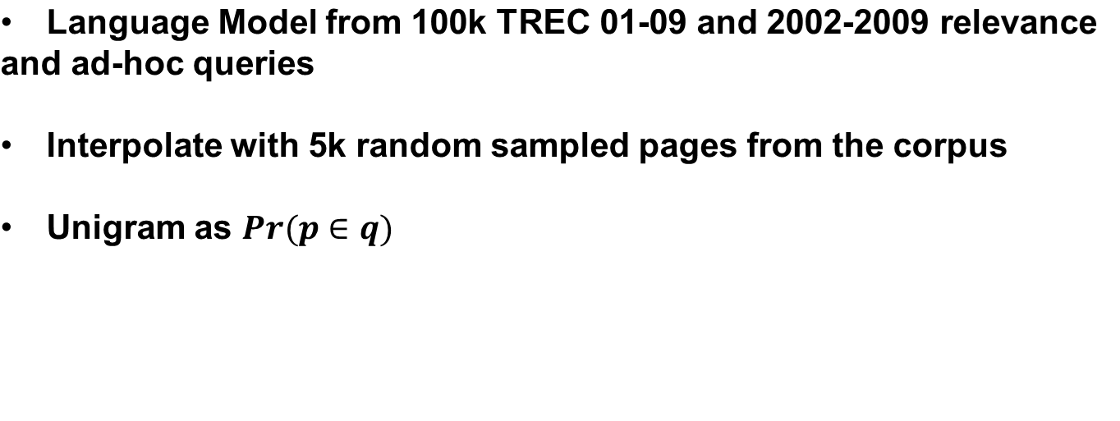
IEEE Big Data 2018

Slide 15
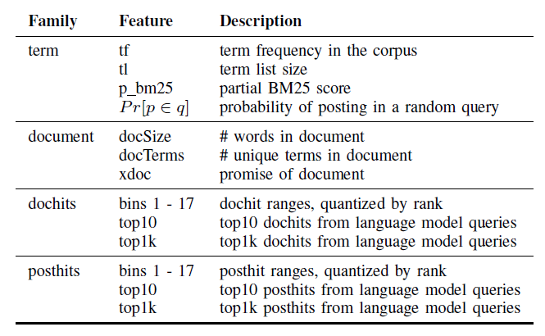
Random Forest
Training size: 1M
Predict on entire index 16 billion postings
Spark cluster on Hadoop
1024 Vcores
3Tb RAM
200 Tb HD
IEEE Big Data 2018

Slide 16
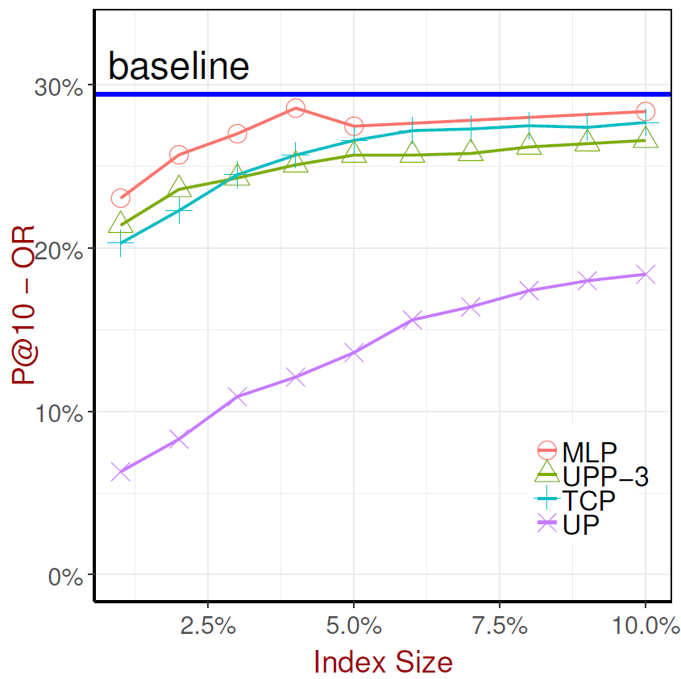
Experimental Results
Machine Learned Pruning
Very high pruning ratios
Quality metrics
P@10
Postings Kept*
Results Kept*
IEEE Big Data 2018
Notes:
We do not know how to optimize for RK, PK

Slide 17
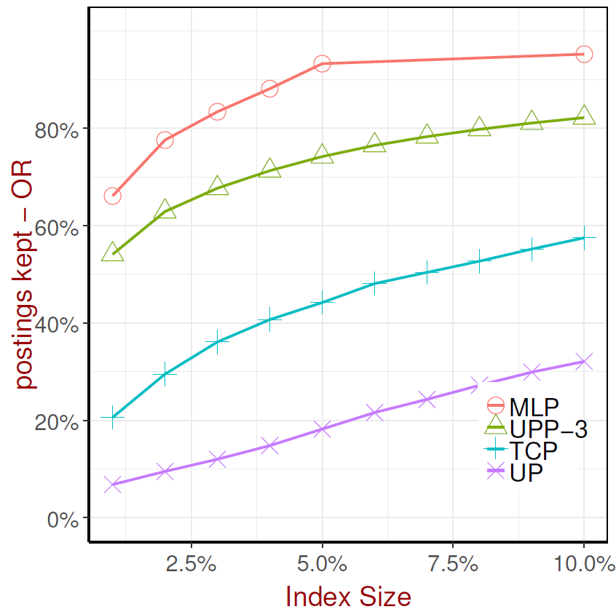
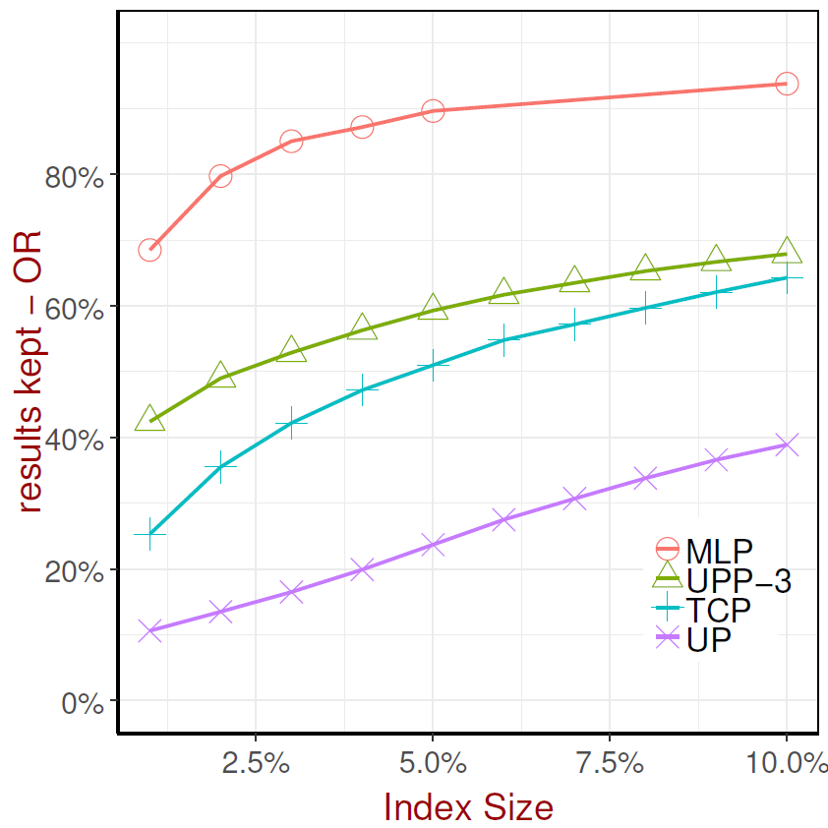
IEEE Big Data 2018
Notes:
PK, RK – may improve results under a complex ranker scenario

Slide 18
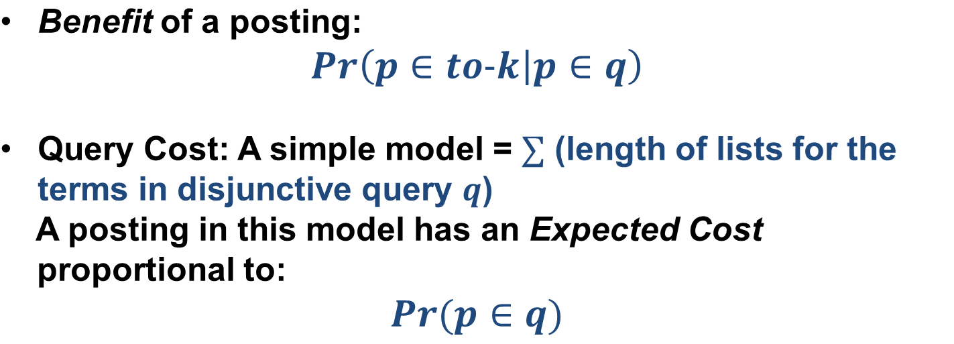
2. Trading-Off between Index Size and Query Cost
IEEE Big Data 2018

Slide 19
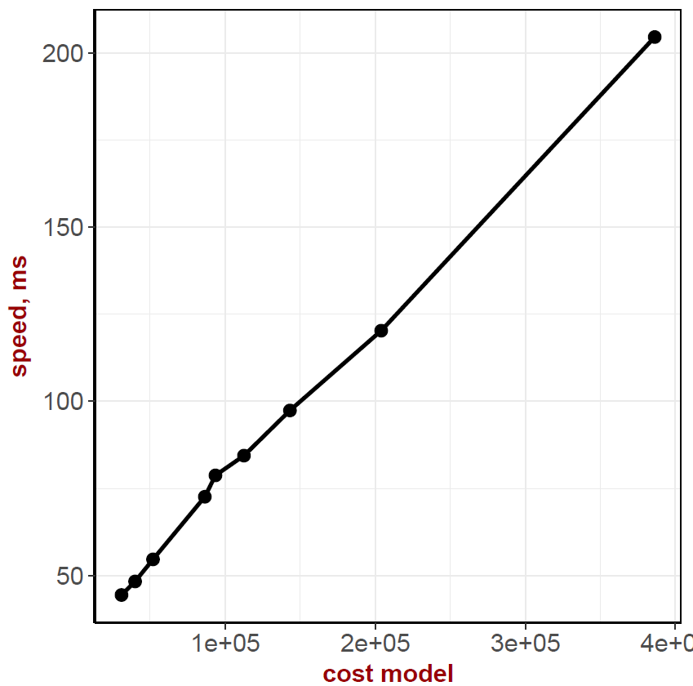
Size Speed Trade-Offs
Actual query speed measurements show near linear relationship to our cost model!
IEEE Big Data 2018

Slide 20
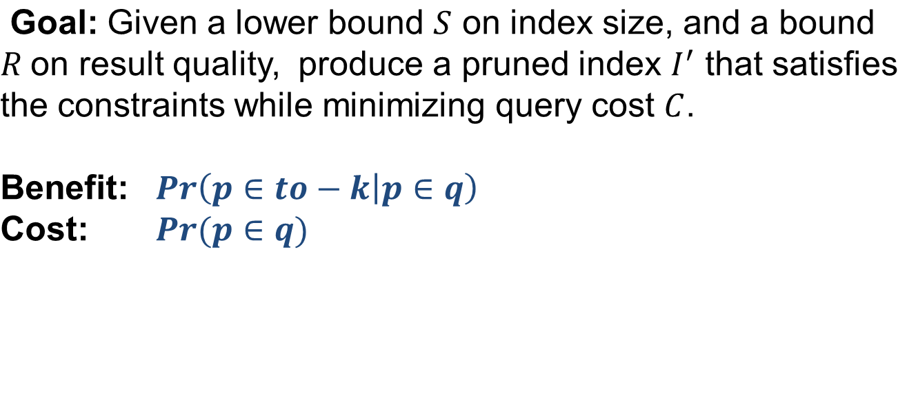
Size Cost Trade-Off
IEEE Big Data 2018

Slide 21
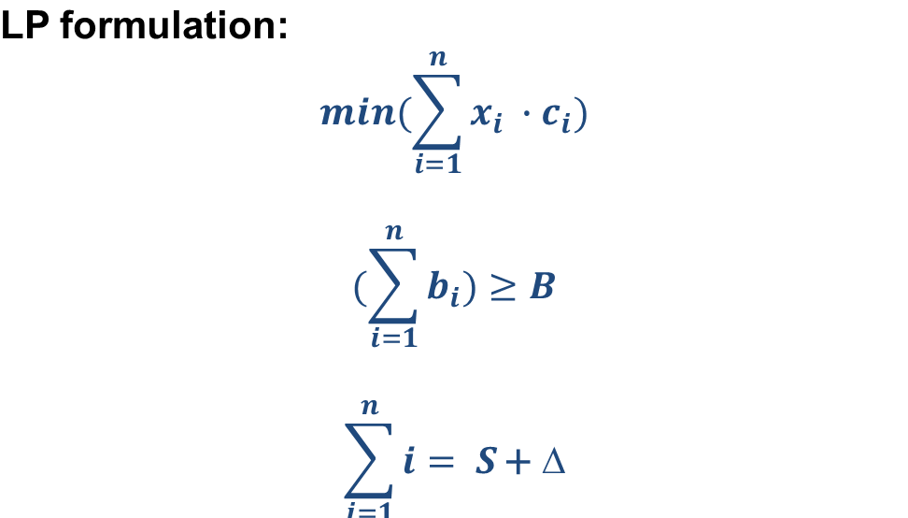
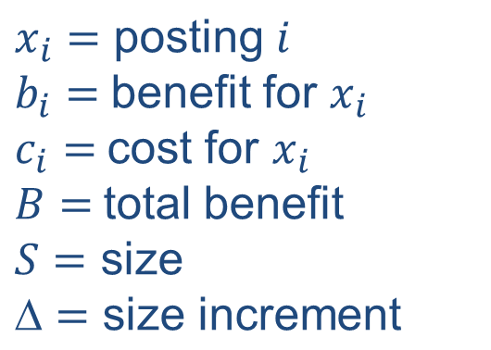
Size Cost Trade-Off
IEEE Big Data 2018
Notes:
This is a linear programming formulation

Slide 22
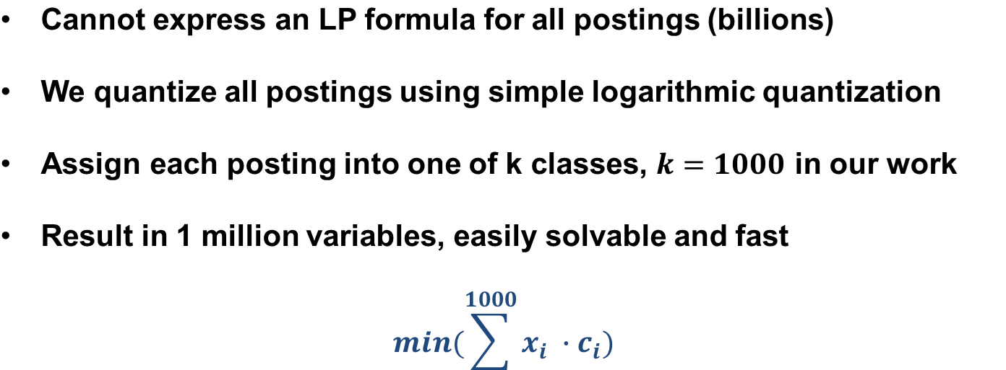
Size Cost Trade-Off
IEEE Big Data 2018

Slide 23
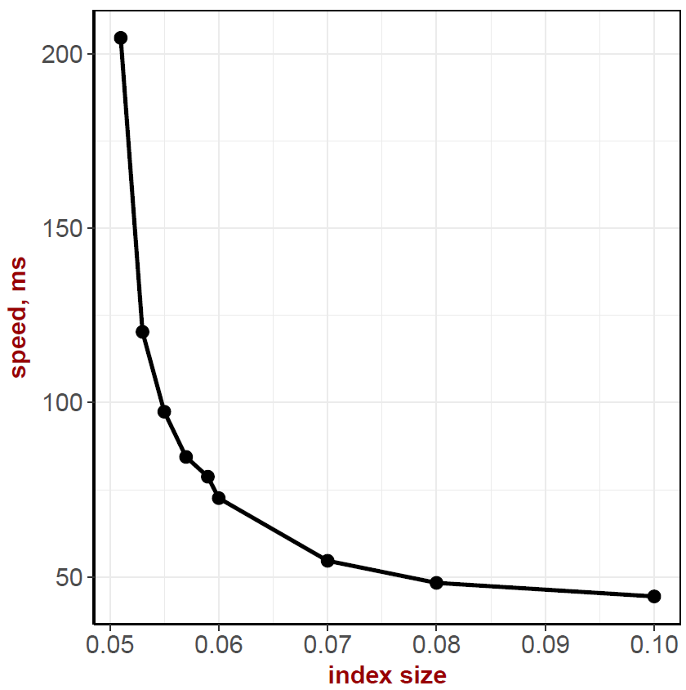
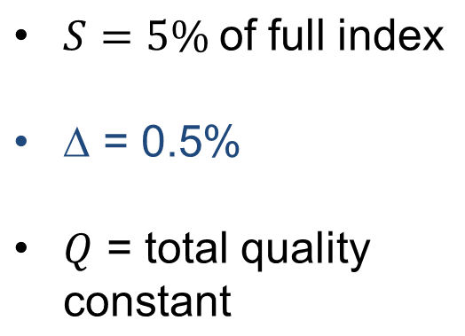
Size Cost Trade-Off
Results
IEEE Big Data 2018

Slide 24
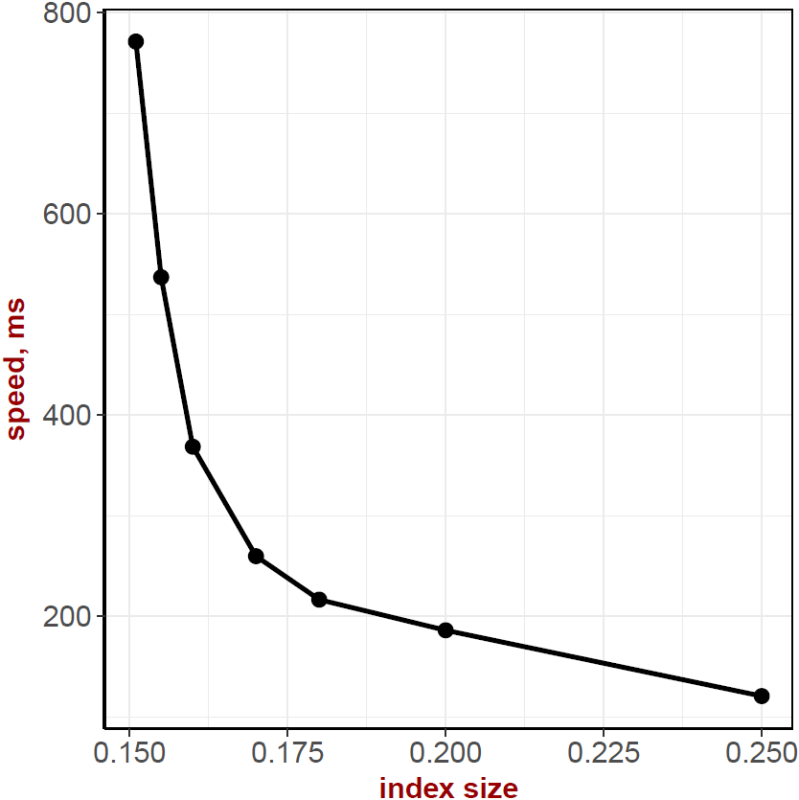
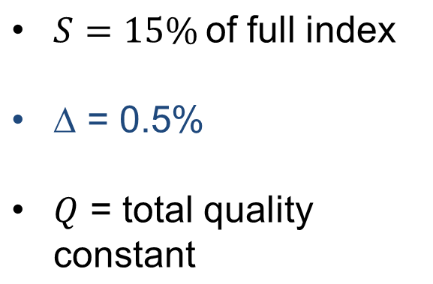
Size Cost Trade-Off
Results
IEEE Big Data 2018

Slide 25
Conclusions
1. Learning to prune. Optimize for size.
2. Significantly increase query processing speed if we allow a very small increment in index size
1 + 2 = optimal size/cost at any index pruning size
IEEE Big Data 2018

Slide 26
Open Questions
We learned to optimize size for a simple ranking function, BM25.
Need to explore learning for complex ranking functions
IEEE Big Data 2018

Slide 27
Thanks for listening!
Questions?
IEEE Big Data 2018

